Slide 1
EYFS Phonics and Early Reading Meeting

Slide 2
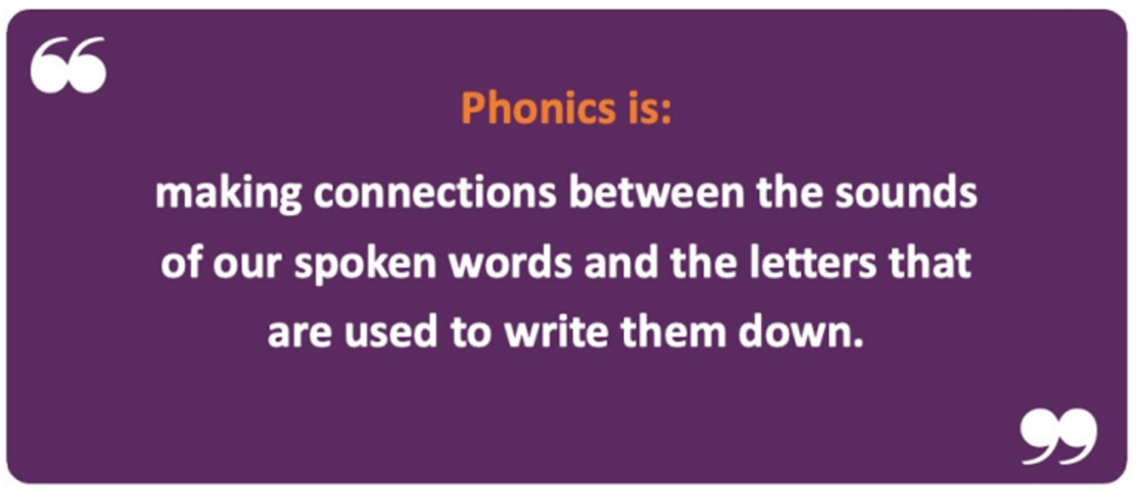
It’s how we learn to read and write.

Slide 3

Little Wandle Letters and Sounds Revised
We use Little Wandle Letters and Sounds Revised as our systematic synthetic phonics (SSP) programme to teach early reading and spelling.
It is a government recommended programme which aims to ensure that all children can fluently decode and read by the end of Year 1.
It is a consistent approach which involves daily phonics teaching sessions, group reads along with catch up interventions and half termly assessments.

Slide 4
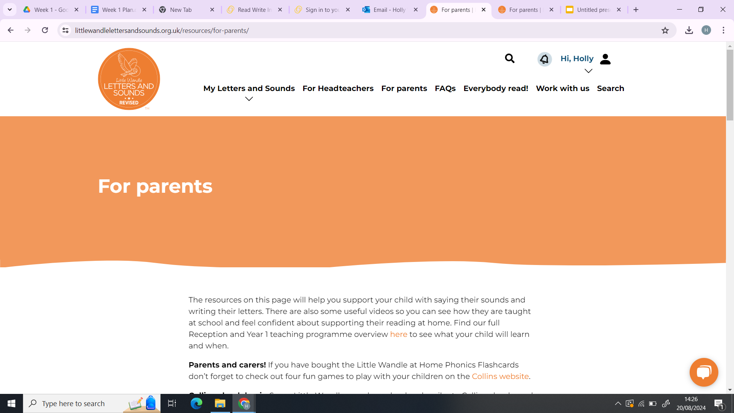
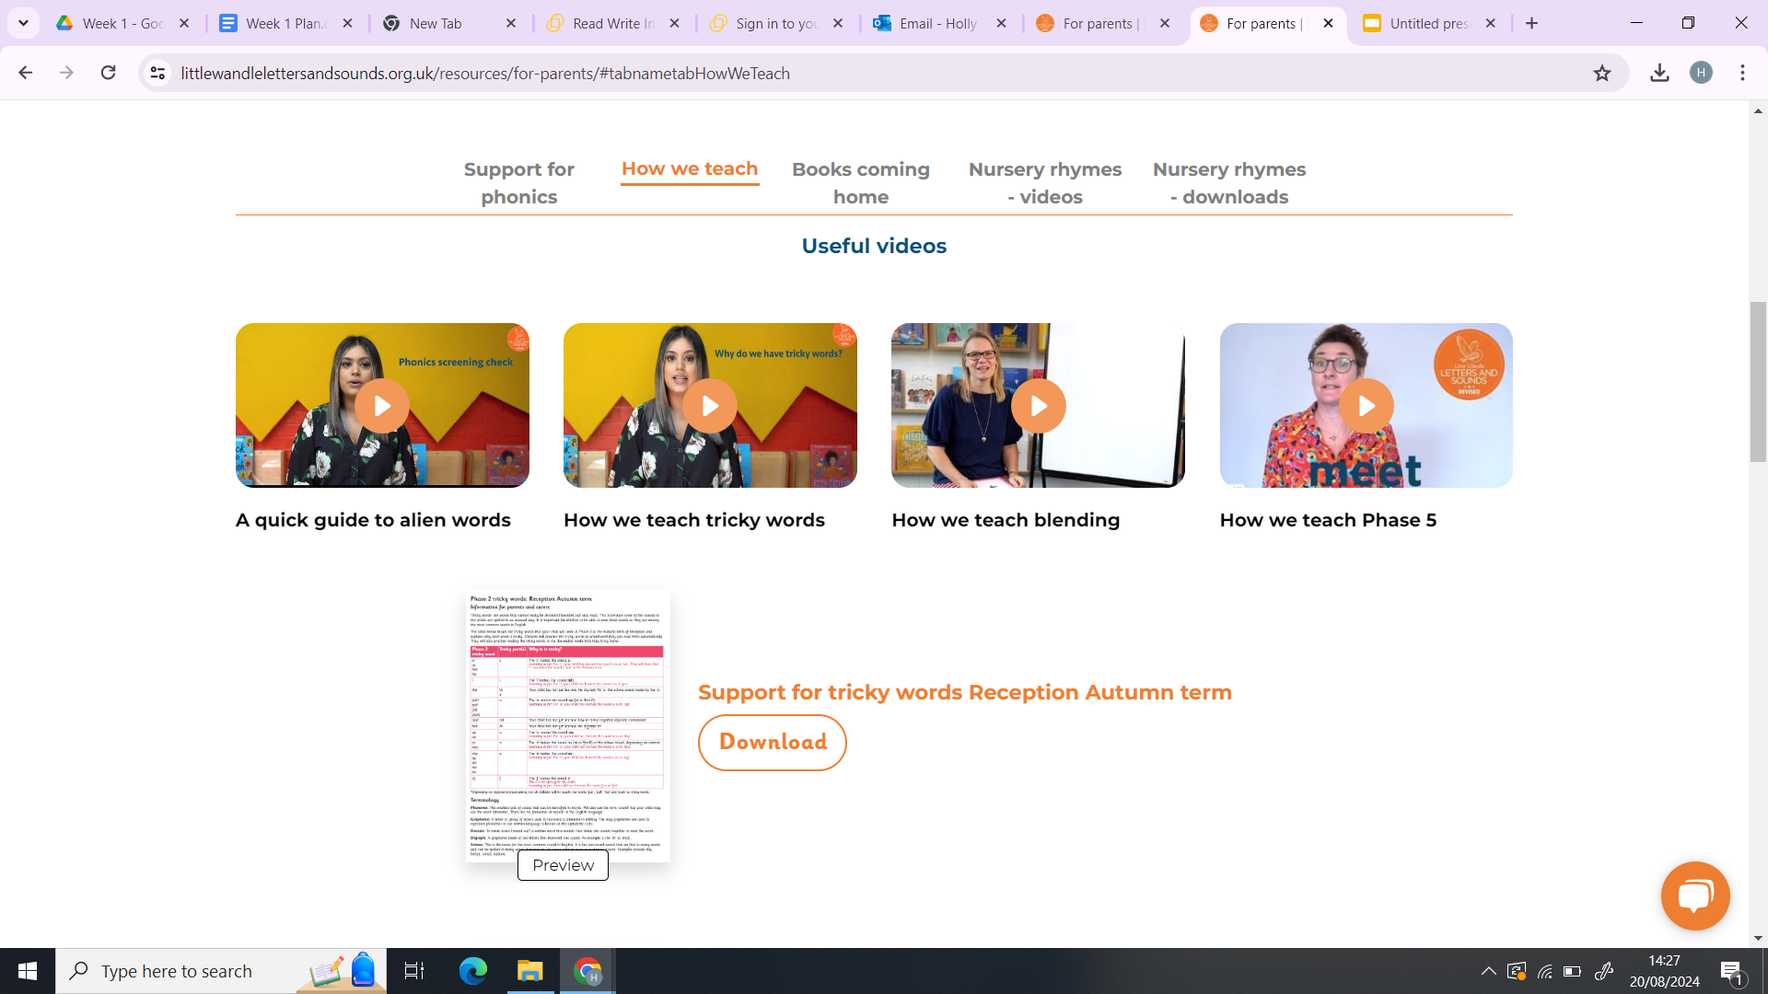
Little Wandle Website - For Parents
https://www.littlewandlelettersandsounds.org.uk/resources/my-letters-and-sounds/
On the Little Wandle website, under the section titled ‘for parents’, you will find all the information that is discussed in our meeting today.

Slide 5
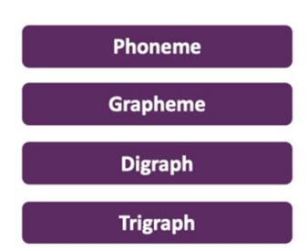
Key Terminology
The smallest unit of sound that can be identified in words.
A letter or group of letters used to represent a particular phoneme when writing.
Two letters that make one sound (phoneme) e.g. sh shop
Three letters that make one sound (phoneme) e.g. igh light

Slide 6
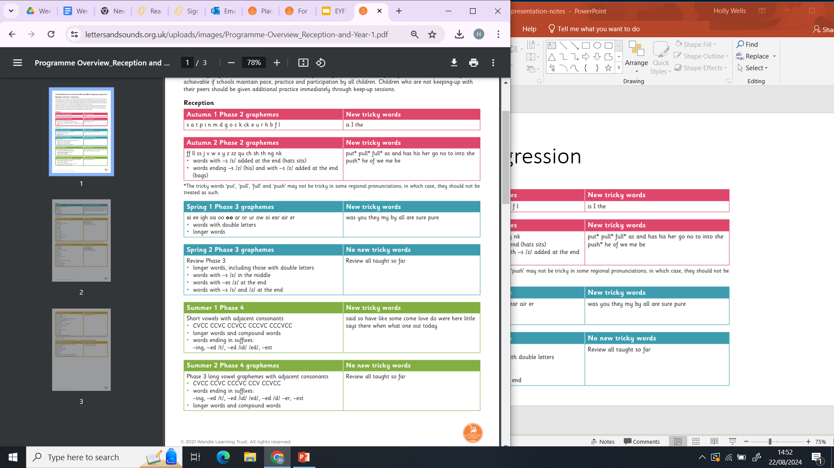
Programme Progression
There are five different phonics phases.
Phase 1 is about developing children’s initial speaking and listening skills – laying the foundations.
In the Autumn term we begin with Phase 2.
Then, in the Spring term, we move on to Phase 3.
In the Summer, we begin Phase 4.
Phase 3 and 4 are both recapped in Year 1, where they will also explore Phase 5.

Slide 7
Term 1 and 2 - Phase 2

Slide 8
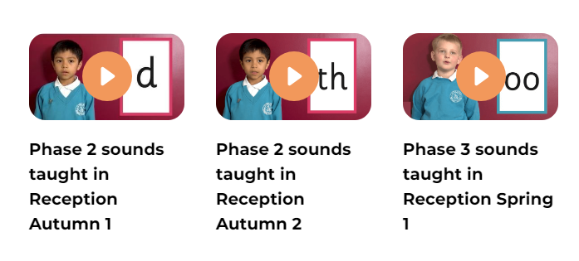
Phase 2 and 3 Sounds Pronunciation
On the Little Wandle website there are videos which show you how to say the sounds.
Go to the ‘for parents’ section and you will find them under ‘support for phonics’.
It is important to say the sounds correctly without the schwar - this is when you add ‘uh’ on the end of a sound.
https://www.littlewandlelettersandsounds.org.uk/resources/for-parents/#tabnametabSupportForPhonics

Slide 9
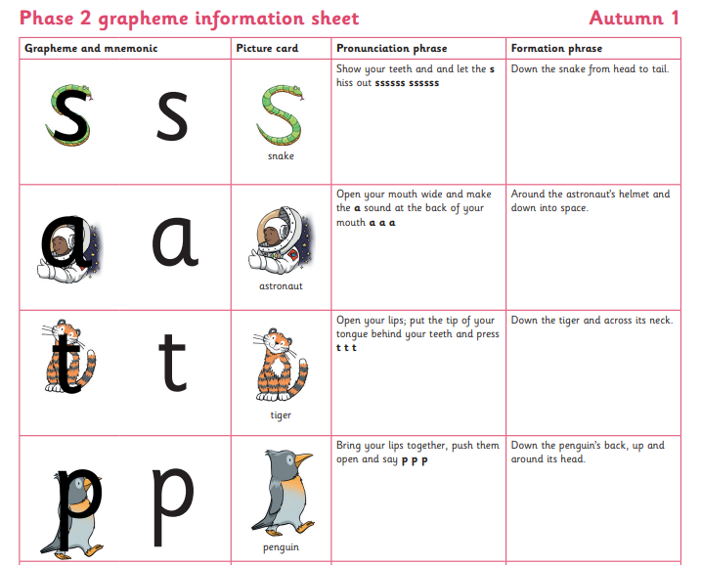
Helpful Pictures and Phrases
Each sound has a picture and pronunciation phrase to go with it to help the children learn how their mouth needs to move to pronounce the sounds.
There are also formation phrases which teach the children how to form the letters when writing.
These are available in the parents section under ‘support for phonics’ for both Phase 2 and 3.

Slide 10
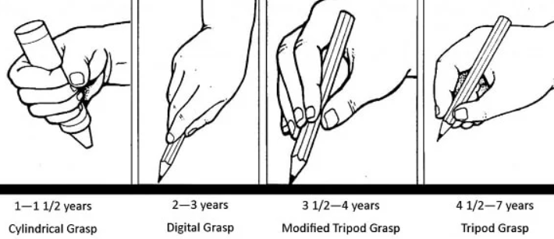
How to hold our pencil:
When children are writing we encourage them to hold their pencil using the tripod grip.
This way of holding a pencil is recommended by many Occupational Therapists and Educational Bodies.
It involves the thumb, forefinger and middle finger forming a triangle and then the fourth finger and pinky supporting the muddle finger. It helps children have good control of the pencil and allows for greater comfort and longevity when writing. See tips below for how to support your child in developing their pencil grip.
https://www.rch.org.au/uploadedfiles/main/content/ot/infosheet_a.pdf

Slide 11
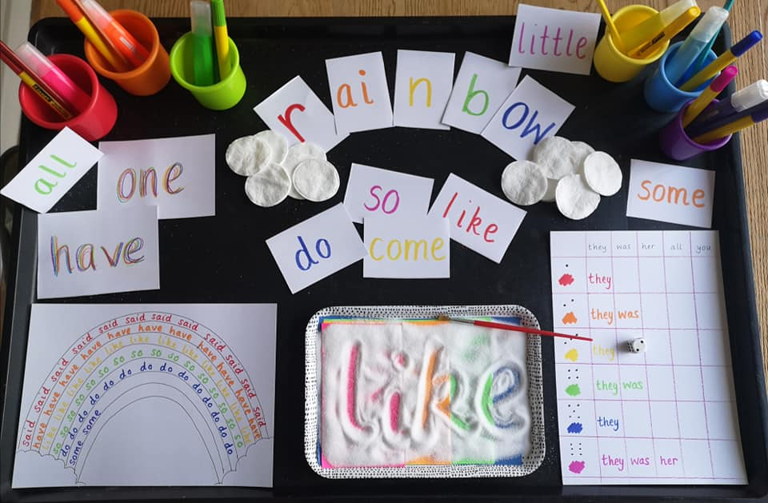
Tricky Words
These are high-frequency words that cannot be decoded by children using the GPCs they have been taught up to that point.
We sometimes call these sight words because we want the children to be able to read them on sight, without needing to decode them.
This helps to increase their reading fluency and comprehension.
For example: the, go, we, is
We will sometimes send tricky word flashcards home for
children to practice.
See the link below for ideas for how to make learning tricky words more fun:
https://stpatsbray.ie/wp-content/uploads/2020/04/Tricky-Word-Work.pdf

Slide 12
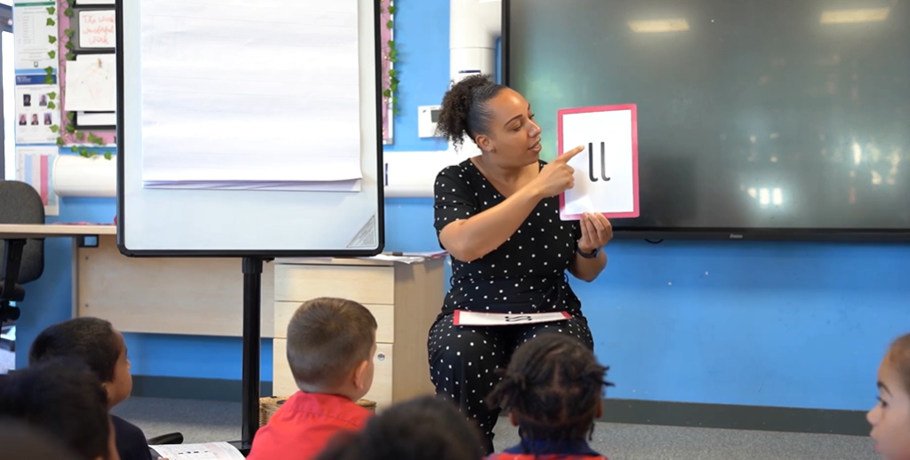
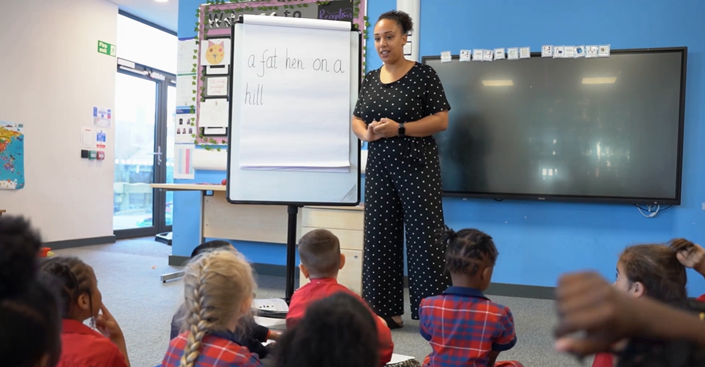
Daily Phonics Session
Revisit and Review: Revise previous learning by recapping phonemes, words and tricky words.
Teach and Practise: New phonemes, words and tricky words. We learn four new phonemes a week with a review on Fridays.
Practise and Apply: The children will apply their learning by reading and/ or writing words and sentences.

Slide 13
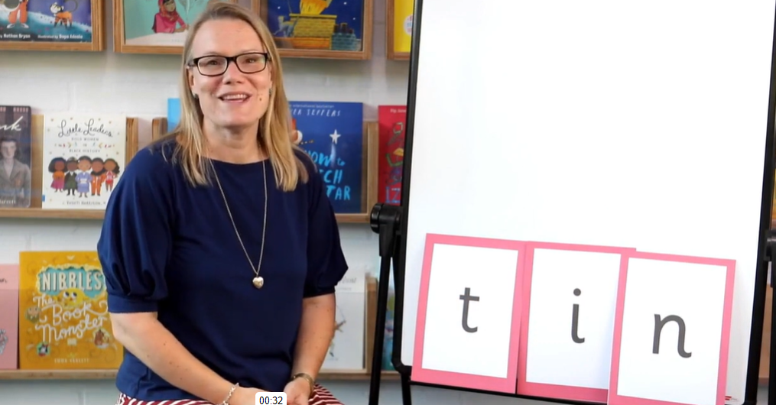
Reading - Blending
To be able to read, children need to be able to sound out graphemes and then blend them together.
For example, with the word like jam, students begin sounding out j/a/m and then blend the sounds together to decode the word.
Some children naturally learn to blend really quickly whereas for others it can take a little longer.
A few ways to support your children with their blending can be to sound out at a faster pace to reduce the space between sounds, use physical gestures to make it multisensory, play blending games and just lots of repetition with the same sounds and words.
For more advice and guidance on blending,
see the video under ‘how we teach’.

Slide 14
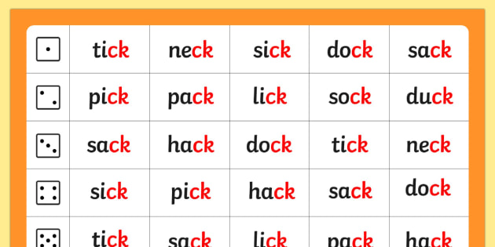
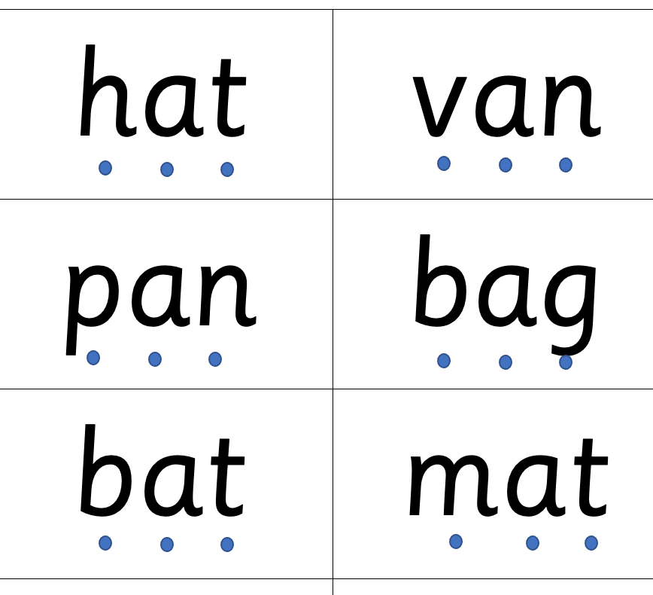
CVC words- consonant vowel consonant
These are words which contain three phonemes.

Slide 15
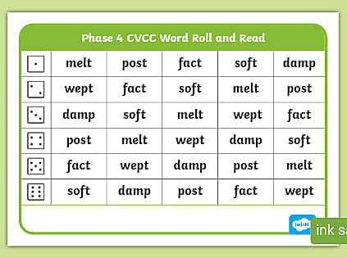
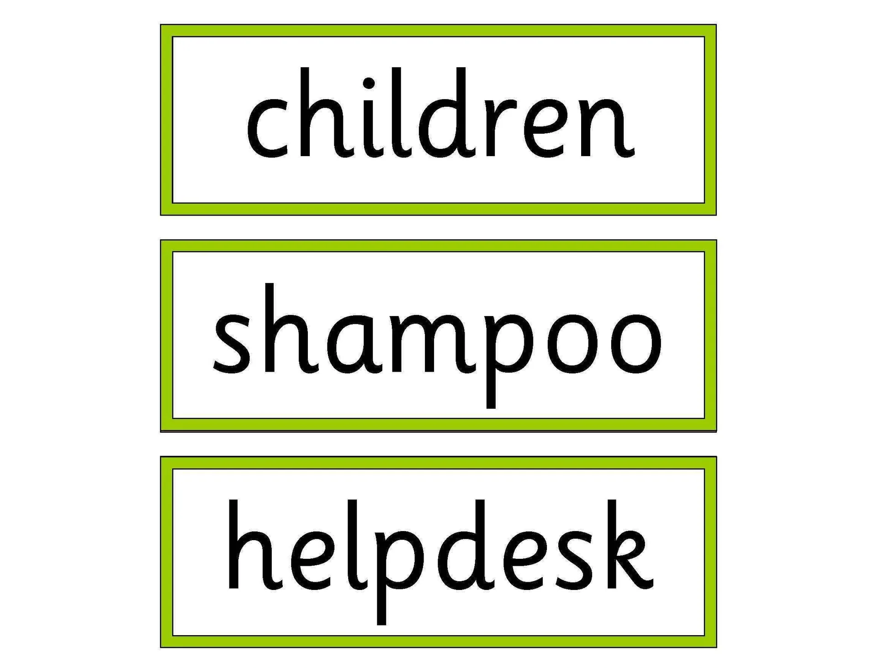
CVCC and Polysyllabic
As we get more confident with our reading and writing we will be able to explore longer words containing more sounds.

Slide 16
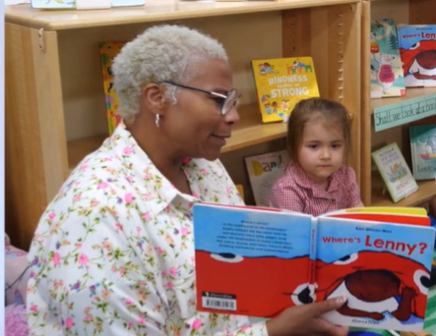
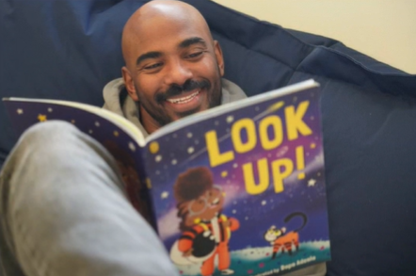
Reading at home
There are two types of reading books that your child will bring home:
Sharing Library Books
These will be books that your child chooses from our school library. Your child will not be able to read these on their own so this is a book for you both to read and enjoy together.
2) Reading Practice Books

Slide 17
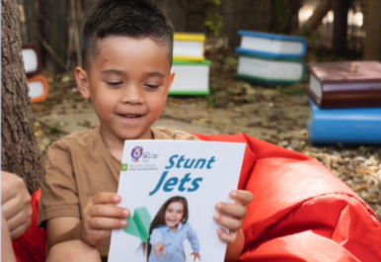
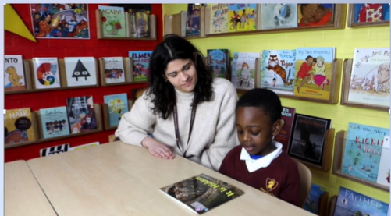
Reading Practice Book
We will send your child home with a new book each week for them to read to you.
The book will be matched to their current reading level.
If your child is reading it with little help, please do not worry that it is too easy. Your child needs to develop fluency (reading accurately and with speed) and confidence in reading too. We will read your child’s book with them the week before in order to help them develop this fluency.
We ask that you listen to them read daily at home (5 mins), giving them lots of praise and support if they can’t read a word. After they have finished, talk about the book together and ask them questions about it to support their understanding of the story.

Slide 18
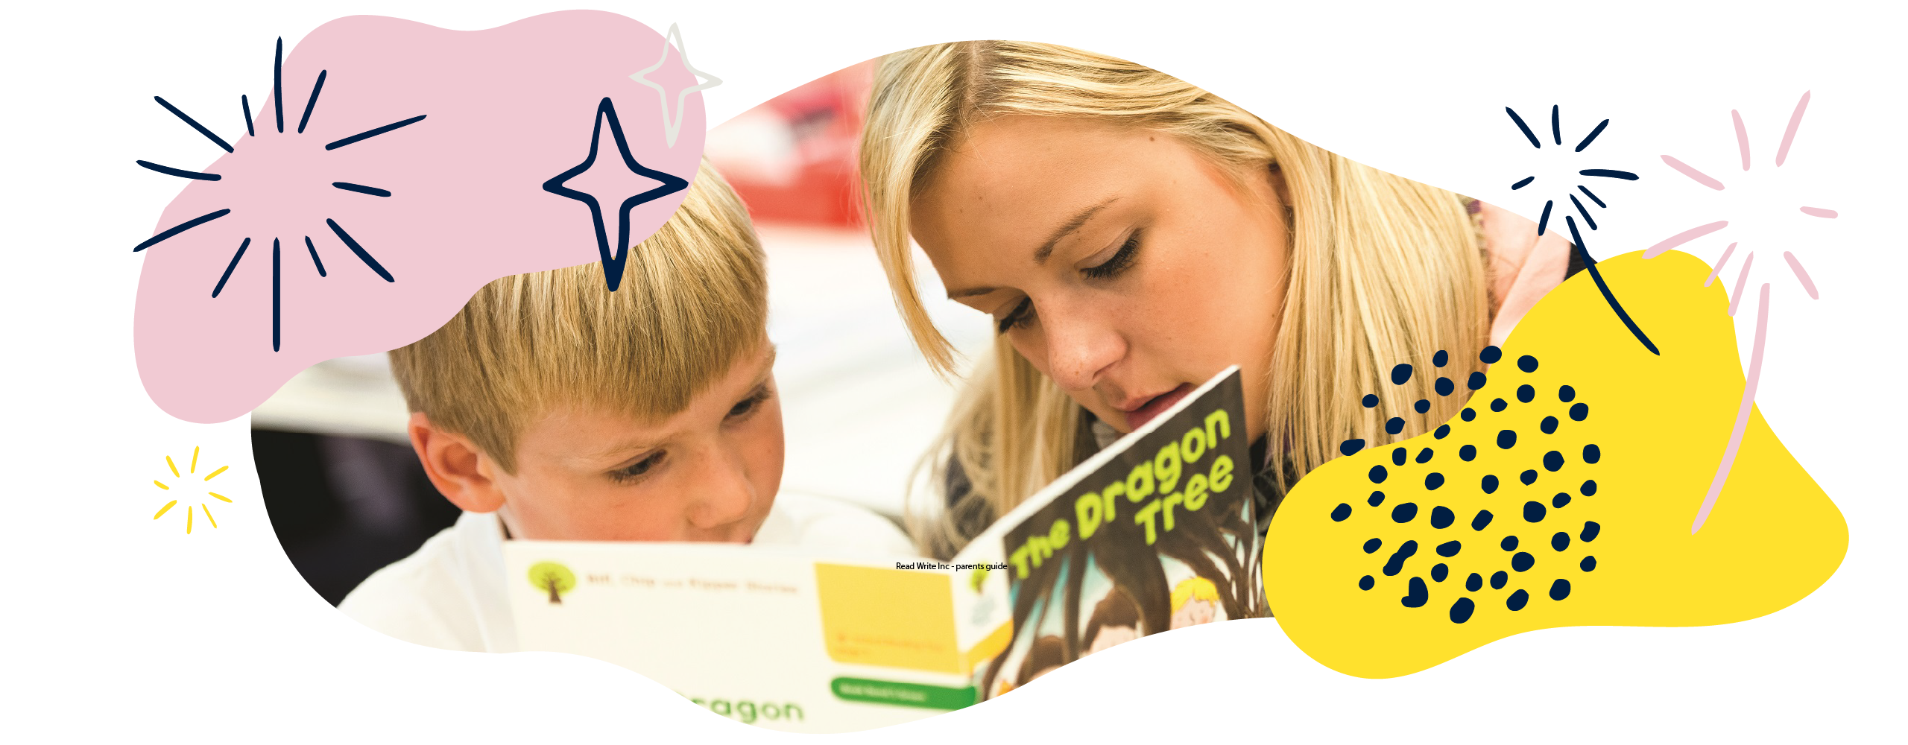
Reading Record
We send home reading practice books in a Reading Record folder.
We ask that each week you make a note in your child’s reading record to let us know how they have been getting on at home with their reading at home.
We will often do the same when we
read with them at school.

Slide 19
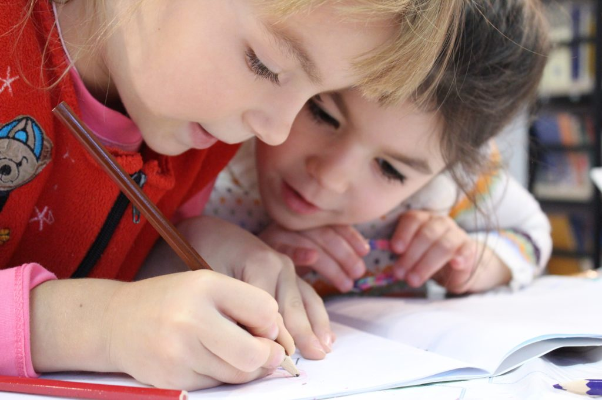
Home Learning Tasks
While we are learning Phase 2 and 3, we will send home a learning task each day in your child’s Phonics Jotter. This short task will involve them practising forming the new graphemes that they have learnt each day and recapping previous graphemes. (Green dot means start here, red means end point)
Please do try your best to regularly do these tasks with your child at home to help build their confidence and ability to be able to say and form their graphemes correctly.
We also send them home with a name tracing card to help them practise writing their name at home. We do this every morning at school too until they are confident with this.

Slide 20
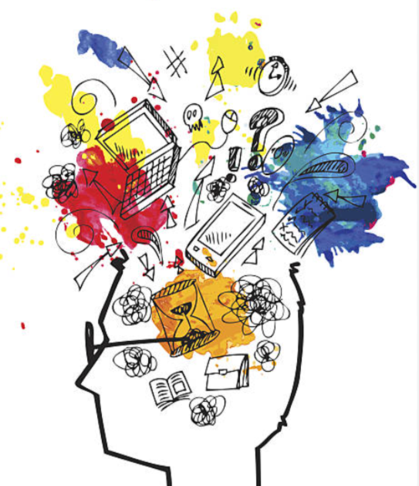
Things to remember:
Reading daily with your child.
Library books you read together, reading record they read to you.
We do not say the schwar (uh sound)
Phonics jotter job each day.
Ensure they form their letters from the correct start and end point.
Name writing practise.
Trying to develop our tripod grip.

